Slide 1
Data Engineering
HDFS

Slide 2

Module Objectives
After completing this course you will be able to:
List the core components of Hadoop
List some of the most common tools in the Hadoop ecosystem
Describe Hadoop’s architecture
Use Hadoop’s file system commands
Recognize when and how to perform administration tasks in hdfs

Slide 3

Hadoop
What is Hadoop?
Hadoop is an open-source distributed processing framework
primarily used to store and process big data
It consists of three core components:
Hdfs
Yarn
MapReduce
It also includes an ever-growing number of other tools
Together they make up the greater Hadoop ecosystem
We will use a couple of these in this course
Did you know?
Hadoop’s name & logo originate from the creator’s son’s toy elephant!

Slide 4
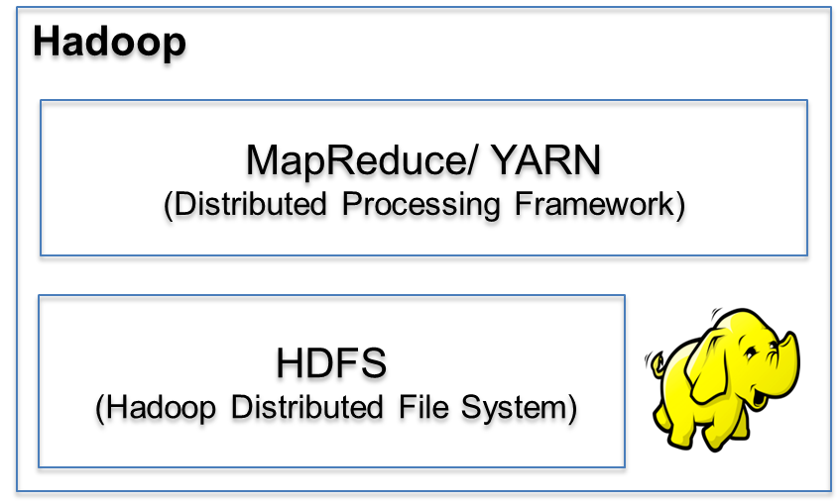
Hadoop Core
Hadoop’s core consists of three components:
Hdfs The storage layer
Yarn The job scheduling and cluster resource management layer
MapReduce The job processing layer

Slide 5

Hadoop’s Ecosystem
SPARK
OOZIE
ZOOKEEPER
Hadoop
MapReduce/ YARN
(Distributed Processing Framework)
PIG
FLUME
HDFS
(Hadoop Distributed File System)
MAHOUT
HIVE
SQOOP
Notes:
The above are only a few of the tools available in the Hadoop ecosystem. It would be almost impossible to include them all in one slide.

Slide 6
Hadoop’s Ecosystem
Here are a few of the additional tools available on Hadoop:
Hive A data warehouse software with a SQL-like API
Pig A platform for writing programs in a data-flow language
Spark A unified analytics engine for large-scale data processing
Flume A stream-processing software
Mahout A software offering machine learning algorithms
Oozie A server-based workflow-scheduling system
ZooKeeper A system for coordination of distributed applications
Sqoop An interface for transferring data from/to relational DBs
There are many, many, many, more …

Slide 7
Hadoop: Cluster Architecture
Each cluster in Hadoop is based on a master-worker architecture:
Client
Master Nodes
Name Node
(Distributed Storage
Manager)
Resource Manager
(Distributed Processing Manager)
Worker Nodes – (Data Nodes & Node Managers)
DN
NM
DN
NM
DN
NM
DN
NM
DN
NM
DN
NM
DN
NM
DN
NM
DN
NM
DN
NM
DN
NM
DN
NM
DN
NM
DN
NM
DN
NM
DN
NM
DN
NM
DN
NM
DN
NM
DN
NM
DN
NM
DN
NM
DN
NM
DN
NM

Slide 8
Hadoop Distributed File System
SPARK
OOZIE
ZOOKEEPER
Hadoop
MapReduce/ YARN
(Distributed Processing Framework)
PIG
FLUME
HDFS
(Hadoop Distributed File System)
MAHOUT
HIVE
SQOOP
Notes:
A data hub is a collection of data from multiple sources organized for distribution, subsetting and sharing. Generally this data distribution is in the form of a hub and spoke architecture.
A data hub differs from a data warehouse in that it is generally unintegrated and often at different grains. It differs from an operational data store because a data hub does not need to be limited to operational data.
A data hub differs from a data lake by homogenizing data and possibly serving data in multiple desired formats, rather than simply storing it in one place, and by adding other value to the data such as de-duplication, quality, security, and a standardized set of query services. A Data Lake tends to store data in one place for availability, and allow/require the consumer to process or add value to the data.
Data Hubs are ideally the "go-to" place for data within an enterprise, so that many point-to-point connections between callers and data suppliers do not need to be made, and so that the Data Hub organization can negotiate deliverables and schedules with various data enclave teams, rather than being an organizational free-for-all as different teams try to get new services and features from many other teams.
=> TODO: Add slide on Data hub vs. data warehouse vs. data lake
=============================================================================
The term data silo refers to the isolation of distinct data sources, which makes it possible for the same information to be duplicated. An approach to handle this issue is to use commonality relationships. Commonality relationships are peer-to-peer relationships between standardized data entities of multiple data models. By keeping track of duplicates, they enable joins and other forms of data merging.
Issues still arise with return sets which are inaccurate, incomplete or impossible to validate. One solution is to support commonality constraints where referential integrity may be enforced between databases.

Slide 9
Hadoop Distributed File System
What is Hdfs? (Hot Dogs For Sale?)
HDFS = Hadoop Distributed File System
It is the primary storage system for Hadoop applications
It provides high performance access to data across the Hadoop cluster
It can be acted upon via all other components of the Hadoop Ecosystem

Slide 10
Name and Data Nodes
Each cluster in hdfs has a master-worker structure:
NameNode
DataNode
A daemon that stores data blocks
Fault Tolerance
The majority of nodes in a cluster
It runs on each “worker node”
A daemon application that runs on a “master node”
Tracks and directs the storage of files on the cluster
It is achieved by keeping replicas of each data block
Each block’s replicas are kept in different data nodes
The default number of replicas is three

Slide 11
Client Machines
Also part of each cluster are Client Machines
These machines do not host a NameNode nor a DataNode
They are responsible for utilising the hadoop cluster
They load data, submit jobs and then view results
Notes:
When data is corrected (but not removed), we can speak of data editing:
https://en.wikipedia.org/wiki/Data_editing

Slide 12
Loading HDFS
Now we have an appreciation for what HDFS is, let’s start using it!
Log in to your virtual machine (follow the login instructions)
Start all Hadoop daemons
Stop them when you’re done
start-all.sh
stop-all.sh
Notes:
We need hduser, because of hosting hadoop on the localhost, which requires accessing privileged files and areas.

Slide 13
Accessing HDFS
Verify that HDFS has loaded by trying to view the contents of a directory
We can also try to pull up the user help guide
hdfs dfs -ls /user
hdfs dfs -lsr /user/testhue
hdfs dfs -help
hdfs dfs –help ls

Slide 14
Files System Commands
Hdfs offers a small range of file system commands
They are inspired by some common Unix commands
They are invoked as options of the hdfs dfs command
Use –mkdir to create a new directory:
Make a personal storage repository within hdfs for the data:
hdfs dfs –mkdir /path/to/newdirectory
hdfs dfs –mkdir /user/your.name/demo
Notes:
The hadoop fs can equivalently be used, as we shall see next.

Slide 15
File System Commands
We can copy data from the local file system into Hadoop, by using put:
Example:
We can also use copyFromLocal to the same effect:
hadoop fs –put path/in/local /path/in/hdfs
hadoop fs –put /home/your.name/Desktop/data.csv /user/your.name/demo
hdfs dfs -copyFromLocal path/in/local
hdfs dfs –copyFromLocal /home/your.name/Desktop/data.csv
Notes:
Filters keep the selection of the subset (including its evaluation) separate from the learning algorithm. They are usually cheaper and tend to avoid overfitting, by having simpler evaluation criteria.
Wrappers evaluate each subset of features by running it against a learning model, but will then follow up with a separate training phase, once the features have been selected.
Embedded techniques are embedded in, and specific to, a model.
Advantages and disadvantages are hard to generalise, as each class actually contains many algorithms.
A separate concern is to decide when to stop searching for the best subset, since exhaustive search is too computationally expensive. One way is by locally optimizing some measure. Another one aims for the subset that maximizes the area projected by the dataset in lower dimensions (to get more variance).

Slide 16
File System Commands
To extract data from Hdfs we can use get:
Example:
We can use copyToLocal to the same effect:
hadoop fs –get /path/in/hdfs path/in/local
hadoop fs –get /user/your.name/demo/data.csv /home/your.name/Desktop
hdfs dfs -copyToLocal path/in/local
hdfs dfs –copyToLocal /home/your.name/Desktop
Notes:
These are similar but: copy to local is limited to the local destination, also less control in getting the file (use get)

Slide 17
File System Commands
So far, we have copied data to and from our local file system and HDFS
We can also copy files within only HDFS
This is useful for creating backups, archiving and auditing our data
Similar to Unix, you can use cp to rename the copied file:
hdfs dfs –cp from/filename to/filename2
hdfs dfs –cp /user/your.name/data.csv /user/your.name/dataBackup/data.csv
hdfs dfs –cp /user/your.name/data.csv /user/your.name/dataBackup/cooldata.csv

Slide 18
File System Commands
Use mv if you don’t need to keep the original:
By now, you should be able to guess what moveFromLocal does:
hdfs dfs –mv filename /newdirectory/filename
hdfs dfs –mv /user/your.name/data.csv /user/your.name/newdir/data.csv
hdfs dfs –moveFromLocal /path/in/local /path/in/hdfs
hdfs dfs –moveFromLocal /home/your.name/Desktop/data.csv /user/your.name/data/data.csv

Slide 19
File System Commands
Use cat to see the contents of a file
You can also use it to copy the source path to the stdout
hdfs dfs –cat filename
hdfs dfs –cat /user/testhue/hdfs/hdfs1/appl_daily.csv
hdfs dfs –cat URI
hdfs dfs –cat file:///cooldata.csv /user/your.name/data.csv

Slide 20
File System Commands
Recall from Unix that rm removed a file and rm –r removed a directory recursively
This is not quite the case with hdfs……
This moves the file to the “Trash”, where it is still recoverable
To delete the “Trash” we use expunge
Now the file will be permanently deleted
hdfs dfs –rm –r path/to/directoryOrFile
hdfs dfs –expunge

Slide 21
File System Commands
Use test to check a file’s properties:
-e checks file existence, returning 0 if true.
-z checks if the file is zero length, returning 0 if true.
-d checks to see if the path is directory, returning 0 if true.
hdfs dfs -test -[ezd] URI
hdfs dfs -test -e filename

Slide 22
File System Commands
Change a file’s permissions with chmod:
Change its associated group with chgrp:
Change its owner with chown:
hdfs dfs –chmod 777 /user/your.name/data.csv
hdfs dfs –chgrp newGroup /user/your.name/data.csv
hdfs dfs –chown newOwner /user/your.name/data.csv

Slide 23
File System Commands
There are also commands for getting stats about files
Use count to check the number of directories, files, and bytes in a path:
Use du to check the size of a file, or the sizes of multiple files and directories:
Use stat to get further information on a path
hdfs dfs –count /user/your.name/data.csv
hdfs dfs –du -s /user/your.name/data.csv
hdfs dfs –stat /user/your.name/data.csv

Slide 24

HDFS Administration Tasks
Administration in an important aspect in overseeing your Hadoop Cluster
Typical Administration Tasks Involve:
Verifying the Overall Health of Your Cluster
Cluster Balancing
Checking Log Files
Managing the Clusters Nodes
Administration Tasks of HDFS
Administration Tasks of MapReduce
Monitoring the Performance of Trackers
All Good!
ADMIN
Notes:
Be aware that many of the admin tasks wont work as we are only using a pseudo cluster.

Slide 25
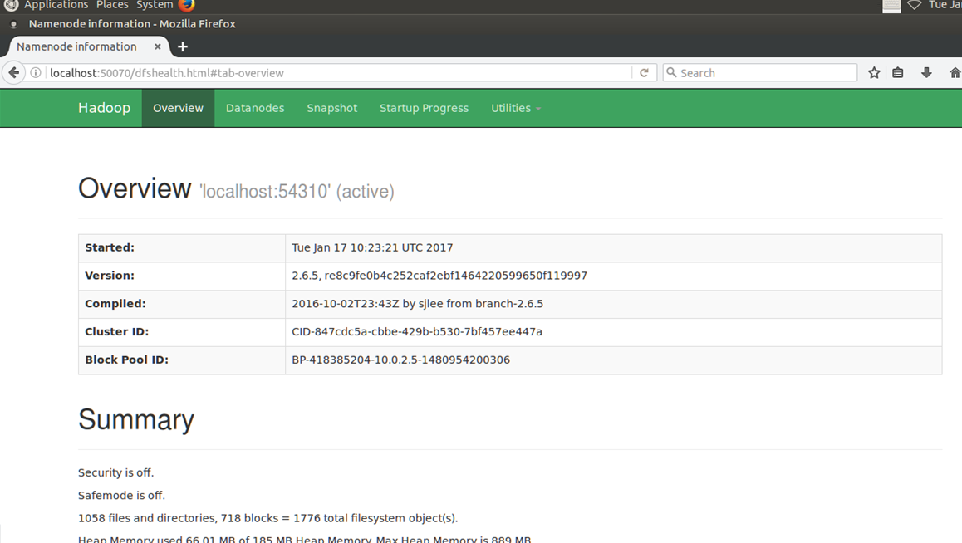
HDFS Administration Tasks
Check the overall health of your cluster by browsing to localhost:50070
Notes:
Demonstrate the tabs and the information they display:
Overview – Summary and NameNode
Datanode – Datanode Information
Startup Progress -

Slide 26
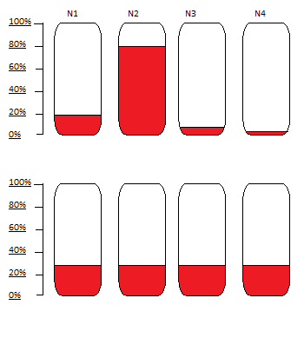
HDFS Administration Tasks: Cluster Balancing
Not all nodes were created equal
Some nodes are faster
Some are more stable
Some nodes have more available storage
Hence some nodes are favourably utilized
This results in unbalanced resource usage
The following commands is used to rebalance the cluster:
hadoop balancer –threshold 30
hdfs balancer [-threshold <threshold>]

Slide 27
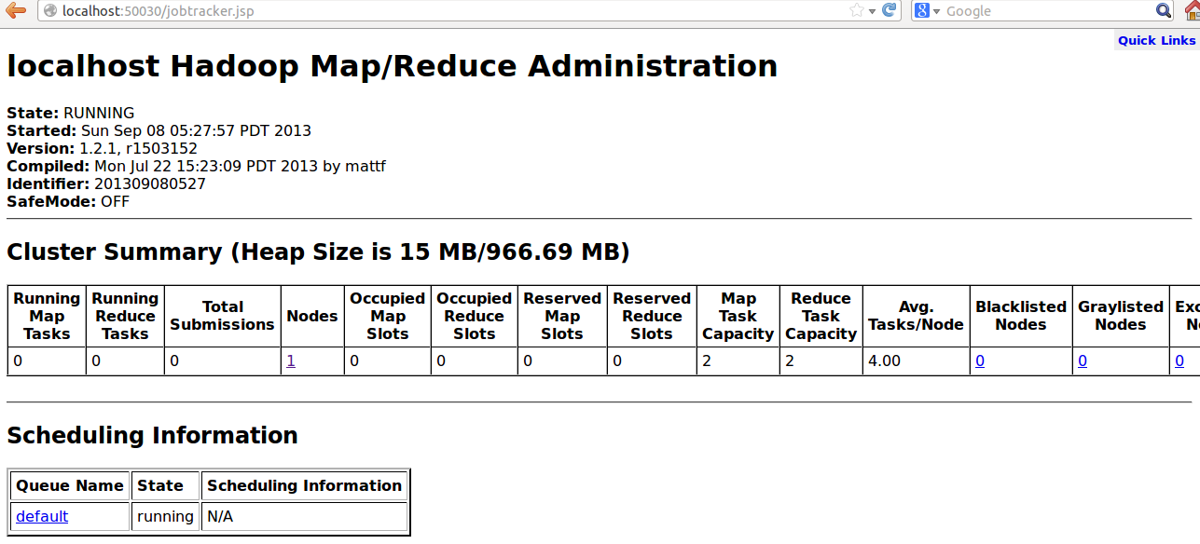
HDFS Administration Tasks: Daemon Logs
Notes:
NOTE : This port is only accessible when a mapreduce job is running.

Slide 28
HDFS Administration Tasks
DataNodes store data
We can run a data node on its own to verify its status
Occasionally if the cluster fails to update, the data nodes will need to be rolled back before updating again
DATA NODE OPTIONS
Regular = Start the Data Node Normally
Rollback = Rollback the Data Node to the Previous Version
Ensure the Dana Nodes have been stopped and the old Hadoop version has been distributed before using this!
Syntax:
hdfs datanode <option>
Example:
hdfs datanode -regular
Rollingupgraderollback = rollback a rolling upgrade operation
Notes:
NOTE: can’t start datanode if address already in use.

Slide 29
HDFS Administration Tasks
The NameNode coordinates the storage for the entire cluster
We can run the name node on its own to verify its status
Use this command, after an update/upgrade to the cluster
If the name node goes down, all is not lost provided you have a secondarynamenode
rollback, the NameNode is rolled back to the previous version (remember to stop the cluster and distribute the previous Hadoop version before using this option)
format, the NameNode is started, formatted, and then stopped
upgrade, the NameNode starts with the upgrade option after a new Hadoop version is distributed
importCheckpoint, an image is loaded from the checkpoint directory and saved into the current directory.
Syntax: hadoop namenode [-format] | [-upgrade] | [-rollback] | [-finalize] | [-importCheckpoint]
Example:hadoop namenode –finalize
finalize, the previous state of the file system is removed, the most recent upgrade becomes permanent, rollback is no longer available, and the NameNode is stopped
Notes:
“Hadoop namenode” will attempt to start a namenode and bind it to port 50070 on the localhost. Note that if the daemons have already been started (start-all.sh), then an error will be thrown since port 50070 is already in use. If not, the namenode can be started independently and pertinent stats can be checked from the browser as usual.

Slide 30
HDFS Administration Tasks
The most extensive administration command available is hdfs dfsadmin
It runs the HDFS dfsadmin client
To view all available options use either
hdfs admin –help
or go to:
https://hadoop.apache.org/docs/current/hadoop-project-dist/
hadoop-hdfs/HDFSCommands.html#dfsadmin

Slide 31
Module Review
What is Hadoop?
What are its core components?
List and describe some of the most common tools in the Hadoop ecosystem
How is hdfs structured?
How can I copy data from my local file system to hdfs?
How do I check if a file is exists in hdfs?

Slide 32
Questions

